Slide 1
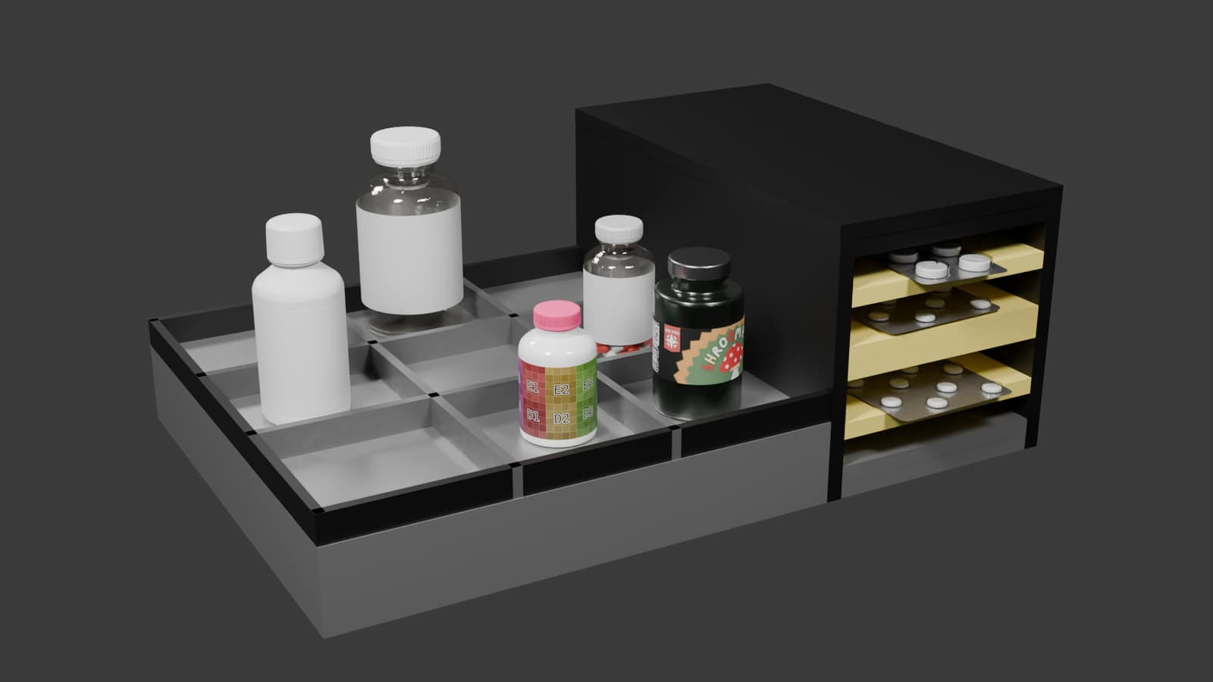
MEDISYNC
Medication
reminders and
tracking
Two device concepts for remembering doses and recording medication-related changes.
Home / desk concept render
A sensed change is not proof that a dose was swallowed.

Slide 2
Medication routines can be hard to track
01
Different schedules
Several medicines can have different times and routines.
02
Different packages
Bottles, liquids and blister packs do not behave the same way.
03
A reminder is not a dose
Someone may pick up a package, get interrupted and put it back.
MediSync focuses on the medication event around a reminder.

Slide 3
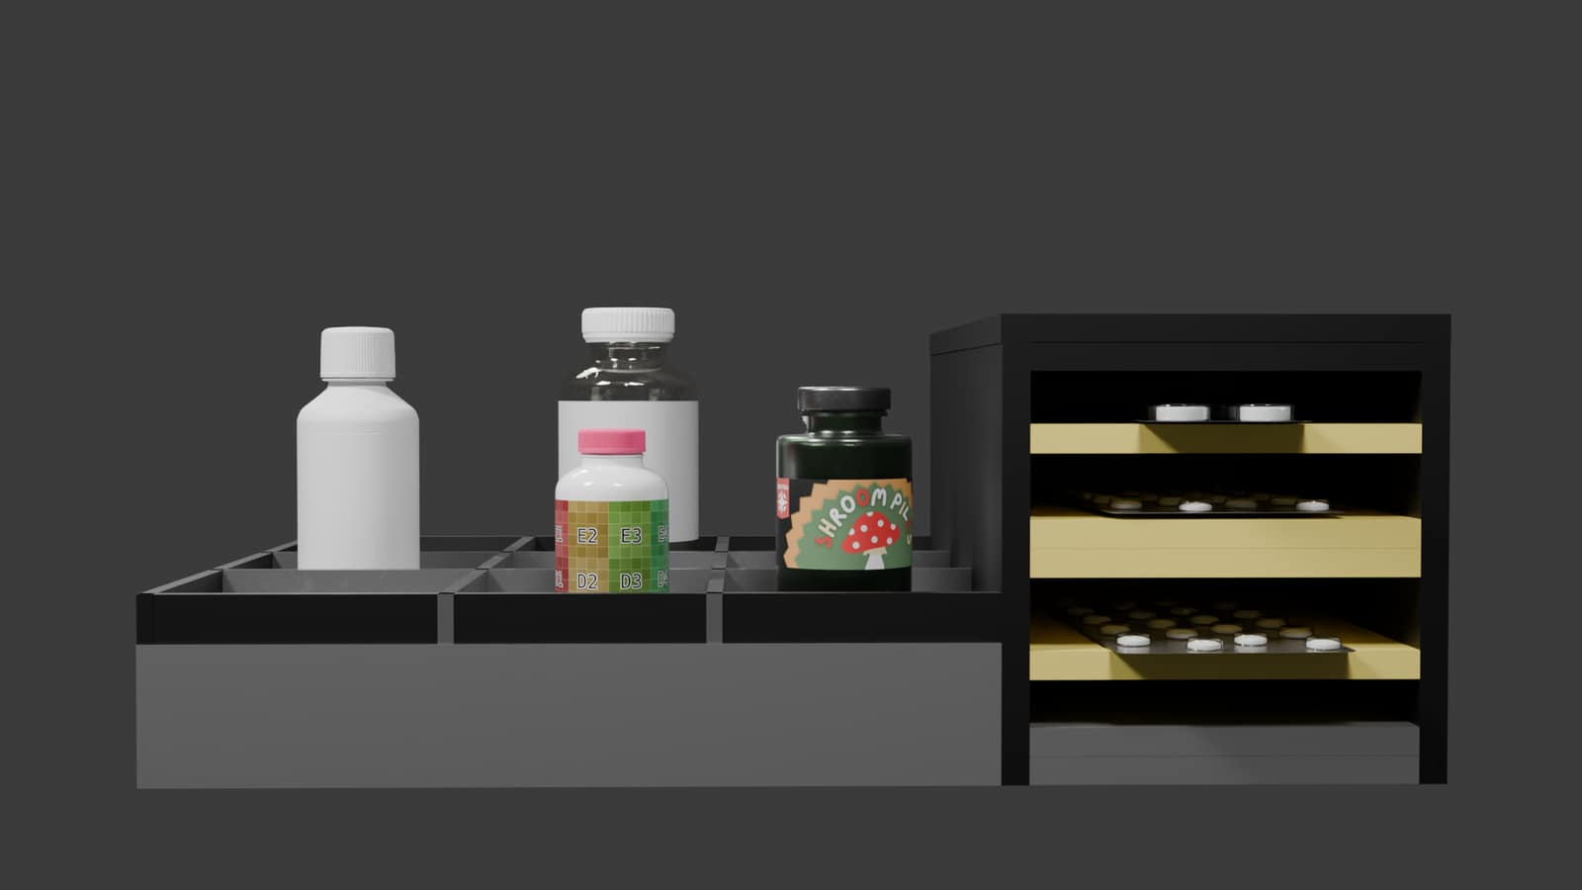
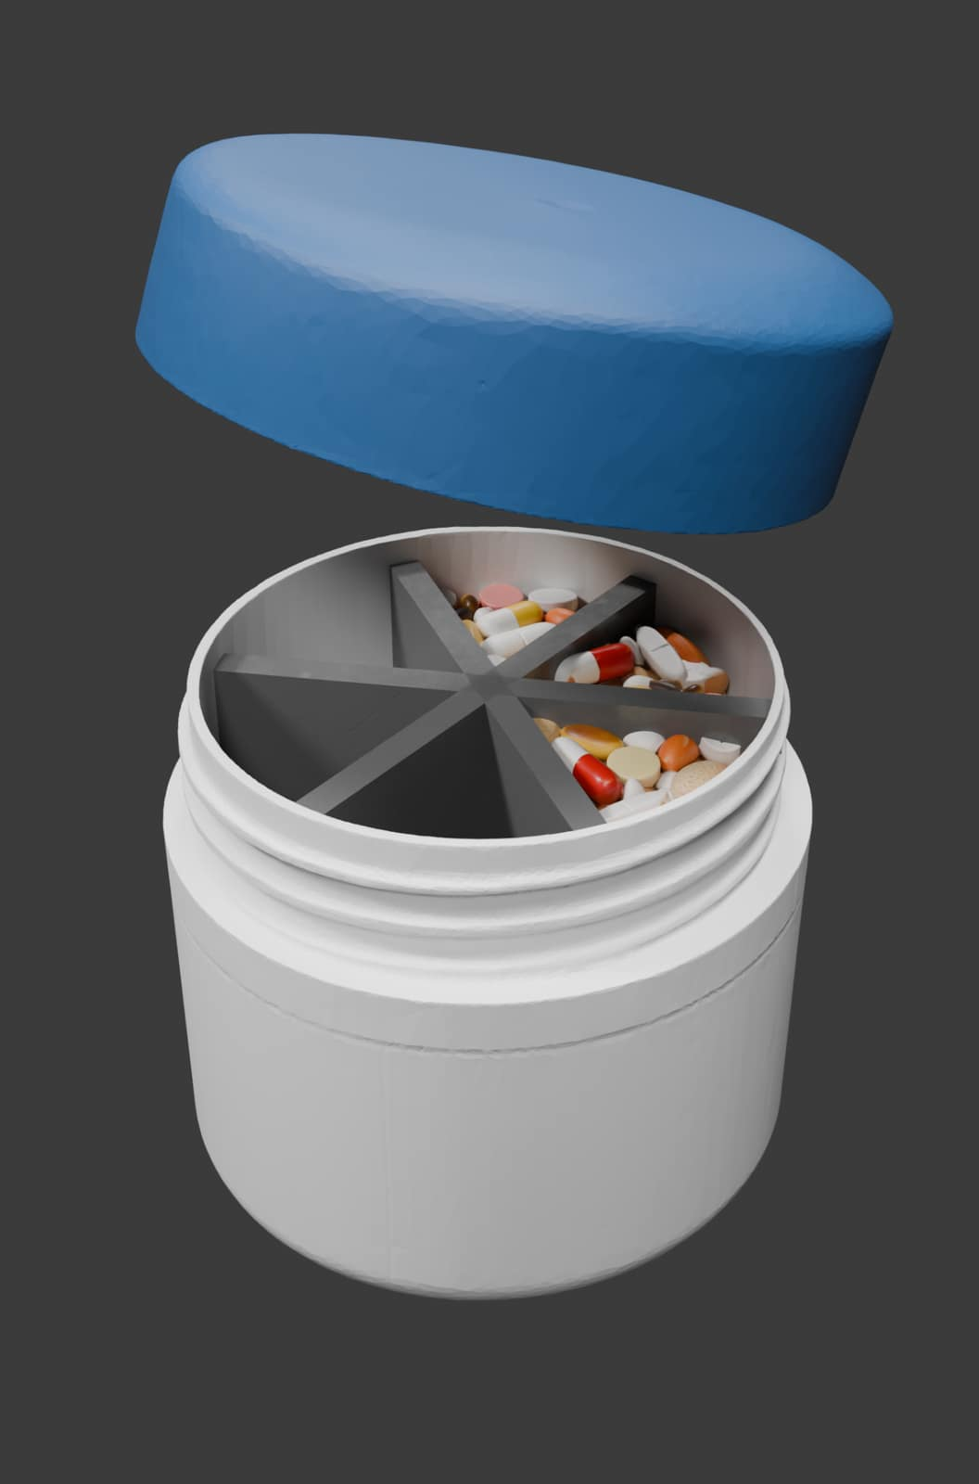
Two versions for different settings
Home / desk
12 positions: 3 pill or container, 3 liquid, 6 blister.
Portable
6 compartments for personal use or travel.
Front concept render
Open case concept render

Slide 4
How the system is meant to work
The device checks for a medication-related change around a scheduled dose.
1
2
3
4
Set up
Remind
Sense
Record
Add the medicine
and schedule
Light, screen and
sound
Compare the package
or position state
Mark the event or
leave it unresolved
It records what the sensors can observe, not whether the person swallowed the medicine.

Slide 5
The sensor depends on the package
POSITION
COUNT
PROTOTYPE SENSING
WHAT TO WATCH FOR
Pill bottles / containers
3
Individual load cells
Movement, placement and weight changes
Liquid medicine
3
Individual load cells
Different bottle shapes and fill levels
Blister packs
6
IR sensing
Material, foil, spacing and sensor alignment
Desk unit: ESP32, OLED and touch controls, buzzer, Wi-Fi/app link, backup power and one LED per position.
IR stays in the prototype, with its packaging limits made clear.

Slide 6
Reminder and follow-up timing
If the event is still unresolved, the local reminder gets stronger, then stops.
5 min before
Scheduled time
+5 min
+10 min
After the last alert
LED turns on
3 beeps once
3 beeps twice
3 beeps three times
Local buzzer stops;
digital escalation can follow
Each alarm stage uses groups of three beeps.

Slide 7
Adaptive learning for desk / home
LOCAL ML: LOGISTIC REGRESSION
GEMMA 4 E2B / E4B
Uses schedule and medication data
Learns from reminder history
Tracks repeated late or missed doses
Finds patterns by medicine and time
The local Gemma model explains a flagged medicine/time pattern and drafts an earlier reminder. The user reviews and approves before the schedule changes.
The local profile stores adherence patterns, reminder preferences, medical context and emergency history. It updates as events are recorded.
Personal learning stays local. Sharing anonymized patterns to improve the general model is optional.
Notes:
Model choices shown are the planned starting stack. Logistic regression runs locally to flag repeated late or missed-dose patterns by medicine and time from schedules, reminder history and recorded events as data builds. Gemma 4 E2B/E4B explains a flagged pattern and drafts reminder wording; it does not calculate the risk score or change the schedule. The user approves any reminder change. These choices need testing before implementation and are not clinically validated.
Model sources: https://ai.google.dev/gemma/docs/core/model_card_4 and https://ai.google.dev/gemma/docs/core

Slide 8
Local and online AI
OFFLINE MODEL: GEMMA 4 E2B / E4B
CLOUD MODEL: GEMINI 3.8 FLASH
Quantized Gemma 4 E2B/E4B runs on the phone. MediSync picks a size that fits available memory. It uses approved medical references and the stored profile; the ESP32 handles sensing and reminders.
With consent, Gemini 3.8 Flash handles deeper analysis and reports. It can use Google Search grounding for current public sources. Detailed explanations appear only when asked.
PRIVACY AND UNCERTAINTY
LOCAL HELP
Health data stays local. Ask before cloud use. If unsure, say so; with consent, use cloud help or guide the user to a professional or authorized caregiver.
Uses approved medical references and the local profile for medicine/schedule questions, interactions, first aid and basic emergency triage.
Emergency AI does not diagnose, prescribe or change treatment.
Notes:
Gemma 4 E2B and E4B are the proposed on-device language-model choices; Google lists these smaller variants for mobile and edge use, with quantized options. Actual memory fit, speed and answer quality must be checked on the target phone. Gemini 3.8 Flash is the proposed opt-in cloud model. Its Google Search grounding capability can retrieve current public sources when used; this is not a guarantee that a source is medically correct. Confirm availability, privacy design and medical accuracy before implementation.
Model sources: https://ai.google.dev/gemma/docs/get_started, https://ai.google.dev/gemma/docs/core, https://ai.google.dev/gemini-api/docs/models/gemini-3.8-flash, and https://ai.google.dev/gemini-api/docs/google-search

Slide 9
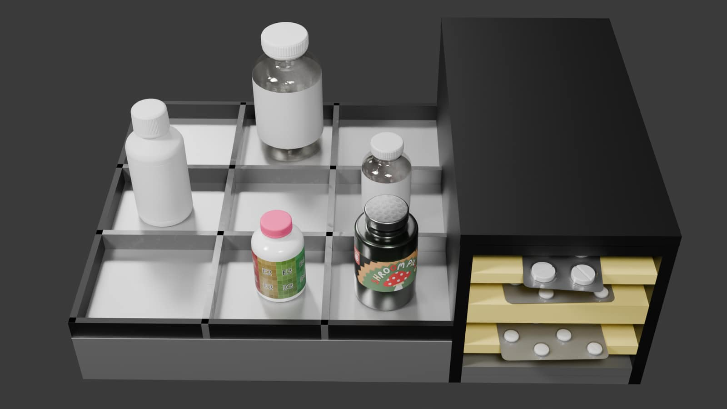
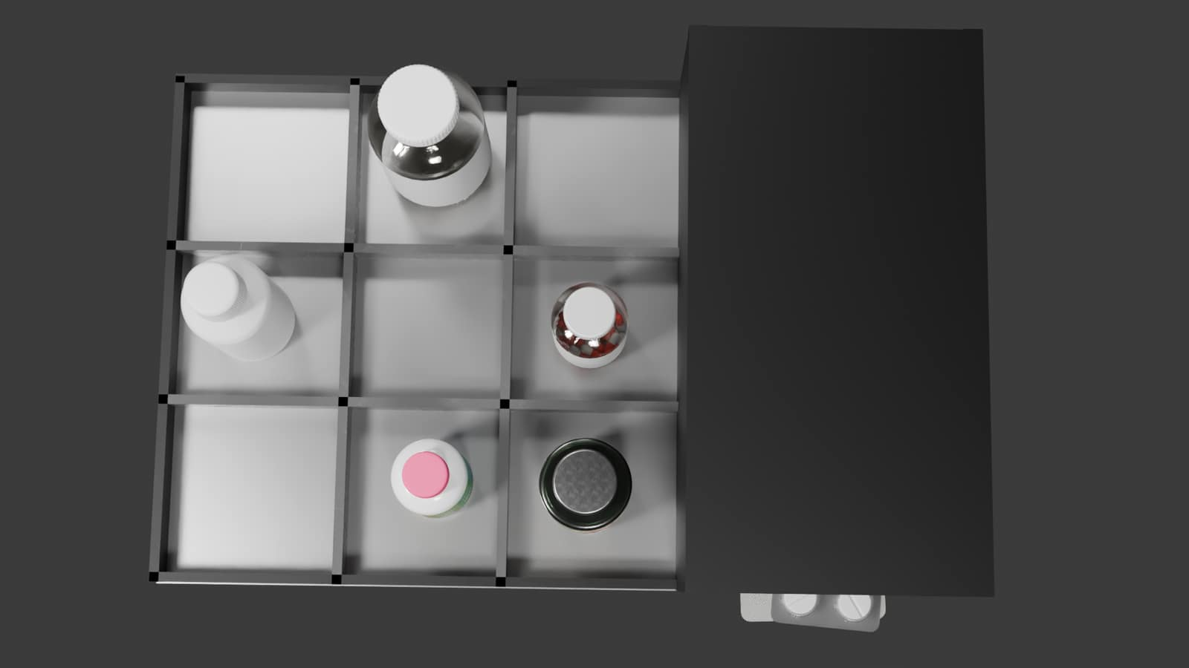
PROTOTYPE RENDERS
Home / desk design views
Angled view: bottle spaces at the front, blister shelves to the side.
Top view: the tray and adjacent storage are easier to see.

Slide 10
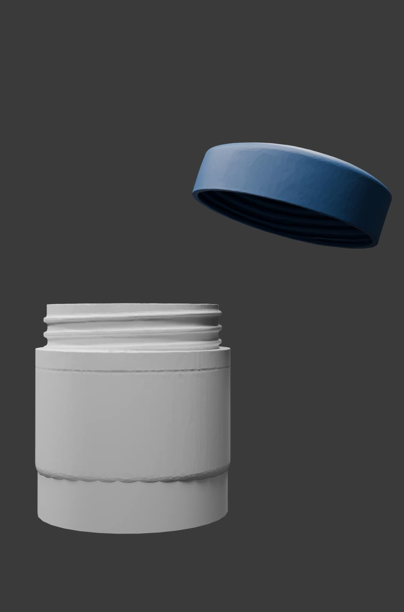
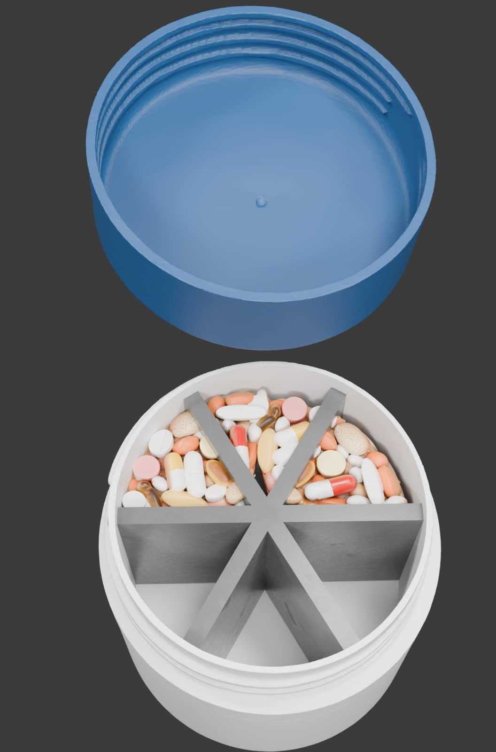
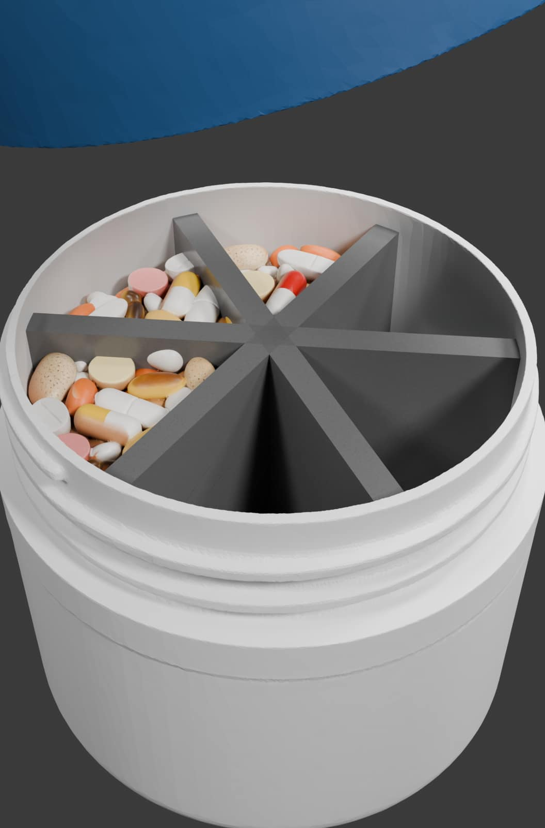
PROTOTYPE RENDERS
Portable case design views
Lid and base
Six-section tray
Open case angle
These renders show the container concept; the electronics are planned separately.

Slide 11
Desk / home version hardware plan
MEDICATION POSITIONS
CONTROLS, ALERTS AND POWER
3 pill or container positions
3 liquid positions
6 blister positions
ESP32 with 2.4 GHz Wi-Fi
0.91-inch OLED and 4 touch switches
Buzzer and 12 position LEDs
1200 mAh, 3.7 V backup battery
USB charging module and antenna
Individual load cells for the 6 bottle / liquid positions; IR sensing for the 6 blister positions.
The current concept uses one indicator LED for each medication position.

Slide 12
Portable version hardware plan
CONTROL
ON THE DEVICE
ESP32-C3
OLED display
3 touch sensors
6 compartment LEDs
Buzzer
SENSING
One shared load cell
with an HX711 amplifier
POWER
Rechargeable battery · USB-C
Users can enter basic settings directly on the device or through the planned app.

Slide 13
HANDWRITTEN COMPONENT LIST
Desk version parts estimate
PARTS AND QUANTITIES
AMOUNT
PARTS AND QUANTITIES
AMOUNT
ESP32 · 1
425
OLED display, 0.91 inch · 1
149
1 kg full-bridge load cell · 2
119 each
Touch switches · 4
7 each
50 kg slim half-bridge load cell · 2
55 each
Battery, 1200 mAh / 3.7 V · 1
58
HX711 amplifier · 4
129 each
USB charging module · 1
19
IR / optical sensor · 2
48 each
2.4 GHz antenna · 1
89
Addressable LEDs · 8+ (10-piece pack)
50 / pack
Wires · 1
15
Buzzer · 1
14
Notebook total: 1,798; buying one full LED pack makes the listed lines add to 1,807.
The note lists 2 full-bridge cells, 2 half-bridge cells, 2 IR units and 8+ LEDs; the current plan needs 6 load-cell positions, 6 IR slots and 12 LEDs. Currency is not marked.

Slide 14
HANDWRITTEN COMPONENT LIST
Portable version parts estimate
PARTS AND QUANTITIES
AMOUNT
PARTS AND QUANTITIES
AMOUNT
ESP32-C3 · 1
252
USB charging module · 1
19
1 kg full-bridge load cell · 1
119
Antenna · 1
65
HX711 amplifier · 1
129
Magnetic reed switch · 1
50
6 LEDs
30 total
LED screen · 1
149
Buzzer · 1
14
Touch sensors · 3
21 each
Battery, 1200 mAh · 1
59
Notebook subtotal: 949 (737 for the first set, plus screen 149 and 3 touch sensors at 21 each).
Currency is not marked in the handwritten list.

Slide 15
Medication setup and replacement
REGISTER A MEDICINE
WHEN A PACKAGE IS REPLACED
QR or barcode
Manual entry
Device screen and touch
Phone app
Reuse the saved weight profile for a similar replacement.
If the package size changes a lot, re-upload or confirm it again in the app.
No RFID tag needs to be moved to a new bottle.
The medicine is assigned to a position after registration.

Slide 16
What counts as a medication event?
Example: the user picks up a bottle, then returns it without removing a dose.
01
02
03
04
Reminder
›
Bottle lifted
›
Same weight on return
›
Still unresolved
The scheduled alert starts
The position changes
No medication-state change is measured
The reminder can continue or escalate
A recorded change still does not prove that the user swallowed the medicine.

Slide 17
What we tried and where it got difficult
IDEA
PROBLEM / CHANGE
RFID tags
Replacement bottles would need re-tagging; removed from the plan.
Camera for blisters
Needs space, steady lighting and more processing.
Motorized dispenser / carousel
Adds moving parts and mechanical failure points.
Pure pill counting
Does not cover liquids and package changes well.
Manual pill-weight entry
Takes effort and becomes unreliable with a new package.
IR for blister packs
Kept for the prototype; foil, geometry and alignment can affect it.

Slide 18
Planned MediSync app and care-team use
WHO CAN BE INCLUDED
ALERTS
Patient
Family
Authorized doctors, nurses and healthcare staff
The planned app could vary reminder and missed-dose messages by age group and disease.
HOSPITALS
ROLE-BASED ACCESS
Medication events could be logged digitally to reduce repetitive tracking work and support care staff.
Authorized care-team members could update schedules. Access would depend on role. Patients could request their tracking data.
This is intended to support clinical work, not replace clinical judgment.

Slide 19
Hospital workflow and alerts
BED AND PRESCRIPTION
EVENT FOLLOW-UP
Assign one desk device to the patient
when the bed is assigned. The doctor
enters the prescription.
Tracks weight/state changes and
response time. Nurse/staff receive
alerts for unresolved events.
MISSED EVENTS
SCHEDULE CHANGES
The doctor is notified only when
missed events become frequent.
Nurses can change schedules.
MediSync notifies the doctor after
each change.
The first hospital version starts without ML.

Slide 20
Hospital dashboard and audit trail
01
Today's schedule
Due and upcoming medication for this patient and bed.
02
Recent events
Recent reminders, responses and medication events that need attention.
03
Patient and bed status
Assigned patient, current bed status and recent schedule changes.
A full clinical audit trail records medication events and schedule changes.

Slide 21
Notifications can fit the care plan
ON THE DEVICE
PERSONAL SETTINGS
LED before the dose time, then the agreed sound reminder and local follow-up if the event stays unresolved.
Message frequency and who gets notified could be set according to the patient's age group, disease and care plan.
IN THE APP
Schedule changes would be limited to people with the right app permissions.
A missed-dose message can go to selected family or authorized care-team members.
These are planned app features, not current clinical recommendations.

Slide 22
Where MediSync could be useful
AT HOME
IN HOSPITALS
For people managing several scheduled medicines, and for family members helping someone keep to a routine.
A digital event log could reduce repetitive dose-tracking work and help staff see which reminders remain unresolved.
PERSONAL USE
WHY IT MAY HELP
The six-compartment portable version is designed for day-to-day use away from the desk device.
One system can handle several package types and pass unresolved events to the right people.
It is meant to assist patients and care staff; people remain responsible for medication decisions.

Slide 23
Pros and cons
POTENTIAL BENEFITS
LIMITS AND COSTS
Reminders plus a sensor-based event record
One desk unit for pills, liquids and blister packs
No RFID tag to move when a bottle is replaced
Optional family or care-team notifications
Package changes and sensor setup need attention
IR can be affected by blister material and alignment
Hardware and connectivity need testing
A detected change does not prove ingestion
MediSync adds tracking and reminders, but it does not replace the patient or care team's judgment.

Slide 24
JUDGE SUMMARY
MediSync in one minute
THE IDEA
WHAT IT DOES NOT CLAIM
A 12-position home / desk unit and a six-compartment portable version remind users and record medication-related changes.
It can sense an event around the medicine. It cannot confirm that the dose was swallowed.
NEXT IDEAS
WHO IT CAN SUPPORT
Desk/home ML learns adherence and suggests reminder changes for user approval. Emergency help runs offline; cloud AI is optional. A camera remains a later idea, pending privacy and accuracy checks.
People at home, family caregivers and authorized hospital care teams, with app access and notifications set by role.
Remind · sense · record · notify

Slide 25
FUTURE SECURITY UPGRADE
Why MediSync could use a TEE
Sensitive information
Medication list, dosage, schedules, allergies, medical context, adherence history and emergency context.
The privacy problem
Keeping data on-device reduces exposure, but normal application storage and memory are still part of the general software environment.
TEE
Protected encryption keys
Sensitive authentication
Selected security operations
TEE
A Trusted Execution Environment is a hardware-backed isolated environment available on supported devices.
Not a replacement for encryption or OS security.
TEE is proposed as a future upgrade; it is not required by the current prototype.

Slide 26
SECURITY ARCHITECTURE
Where TEE fits into MediSync
USER Medication + health context
MEDISYNC APP Local-first application
OPTIONAL CLOUD AI
Only with explicit consent
Deeper analysis / reports
Current public information when available
ENCRYPTED LOCAL DATA Health profile + adherence history
TEE-BACKED SECURITY Keys • authentication • selected protected operations
LOCAL AI Uses only authorized local context
USER CONSENT
TEE is a security boundary for selected operations — not an AI model and not a guarantee of complete security.

Slide 27
SECURITY TRADE-OFF
What TEE adds — and what it does not
01 Stronger key protection
Cryptographic keys can be hardware-backed on supported devices.
02 Isolation
Selected sensitive operations can run outside the normal application environment.
03 Privacy layer
Adds another protection boundary around sensitive MediSync assets.
04 Device-dependent
TEE capabilities depend on the phone hardware and operating system.
IMPORTANT TEE does not automatically secure the whole app or AI, prevent every attack, or replace encryption, permissions and secure coding.
MediSync current prototype: local-first privacy. TEE: planned future security upgrade.

